Slide 1

IMMERSED TUBE TUNNEL PROJECT IN IZMIR

Slide 2
Members

Slide 3
Content
General Overview
Ground Profile
Bridge Properties
Artificial Island
Immersed Tube Tunnel

Slide 4
General Overview

Slide 5
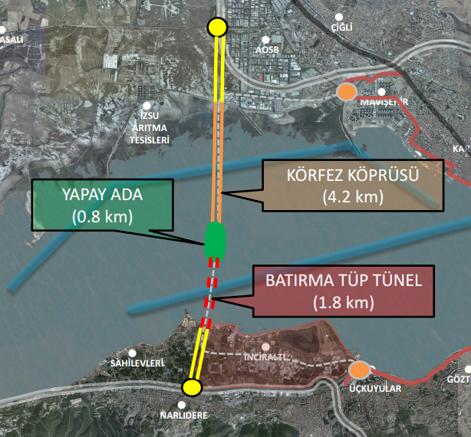
About Project
Location & Properties

Slide 6
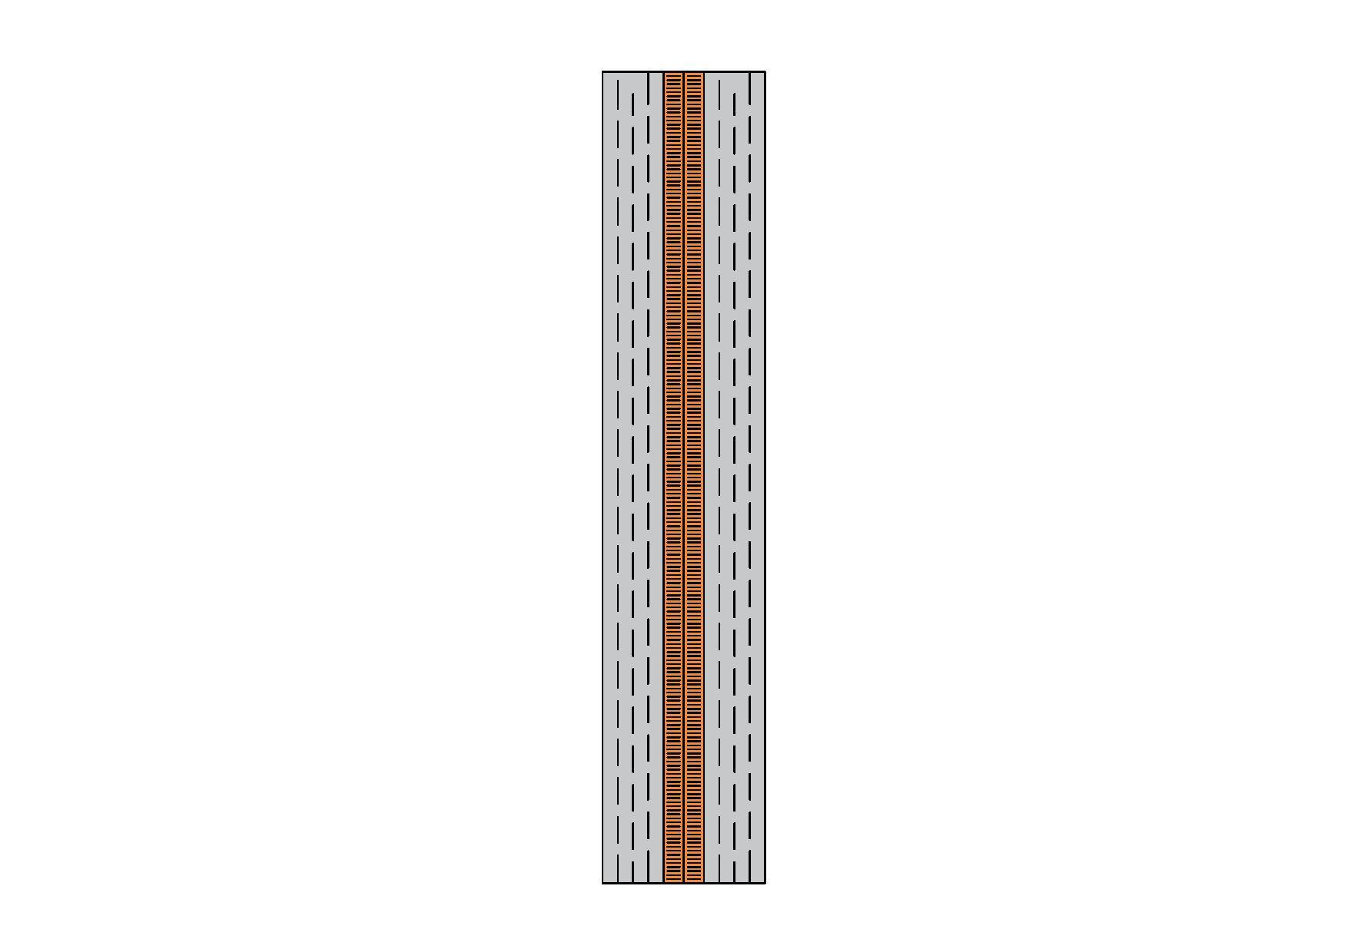
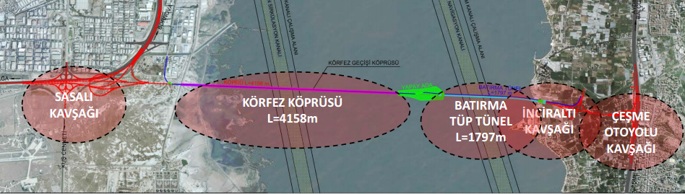
About Project
Positioning
Possible Road Types & Capacities
Importance

Slide 7
Process
Determined Problems
Design Process and Detailing
Flow & Wave
Wind
Foundation
Bathymetry
Tectonic Faults

Slide 8
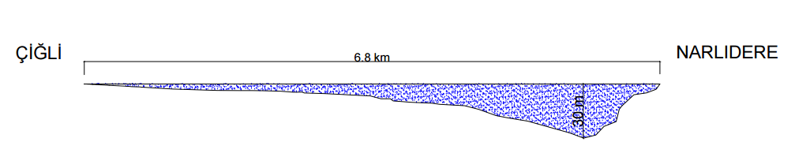
Bathymetry
Almost 30 m

Slide 9
Ground Profile

Slide 10
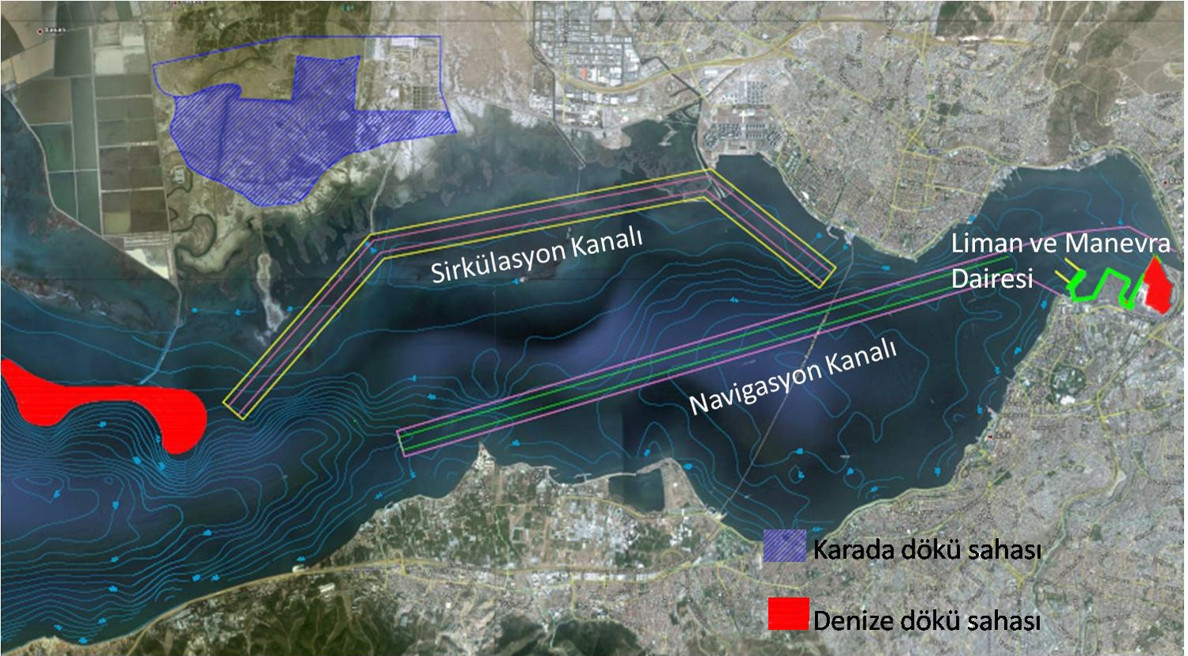
Channels

Slide 11
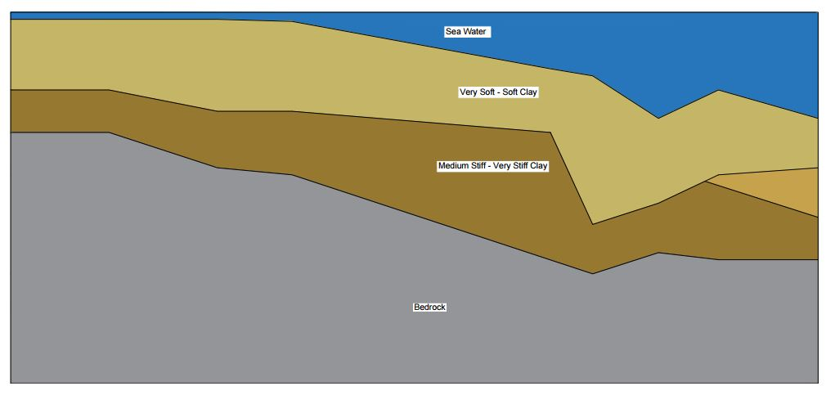
Soil Profile

Slide 12
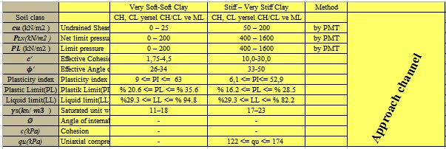
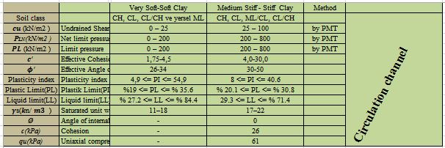
Soil Parameters

Slide 13
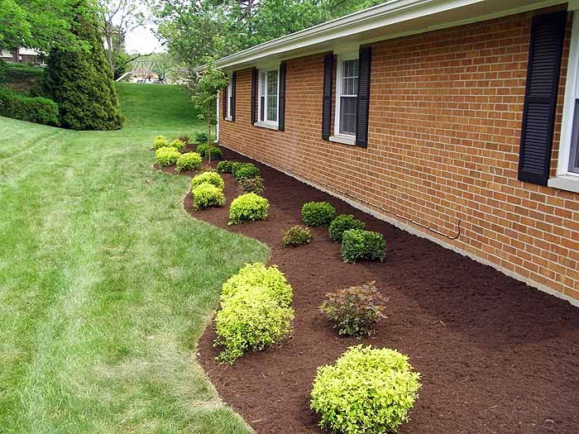
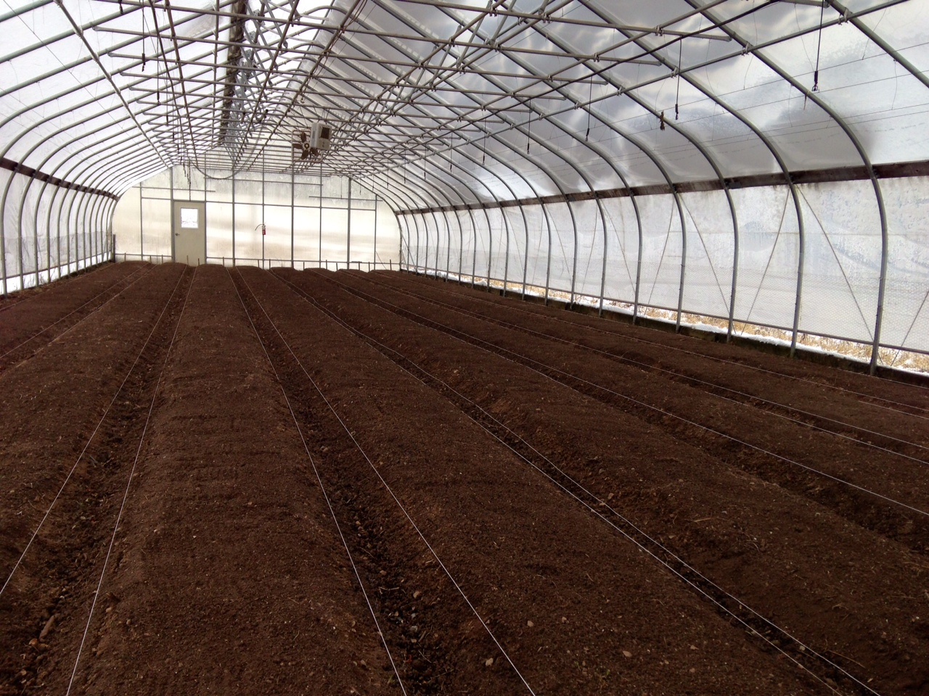
Areas of usage
Landscape
Greenhouse

Slide 14
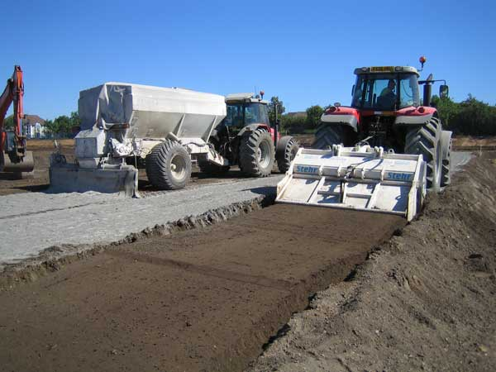
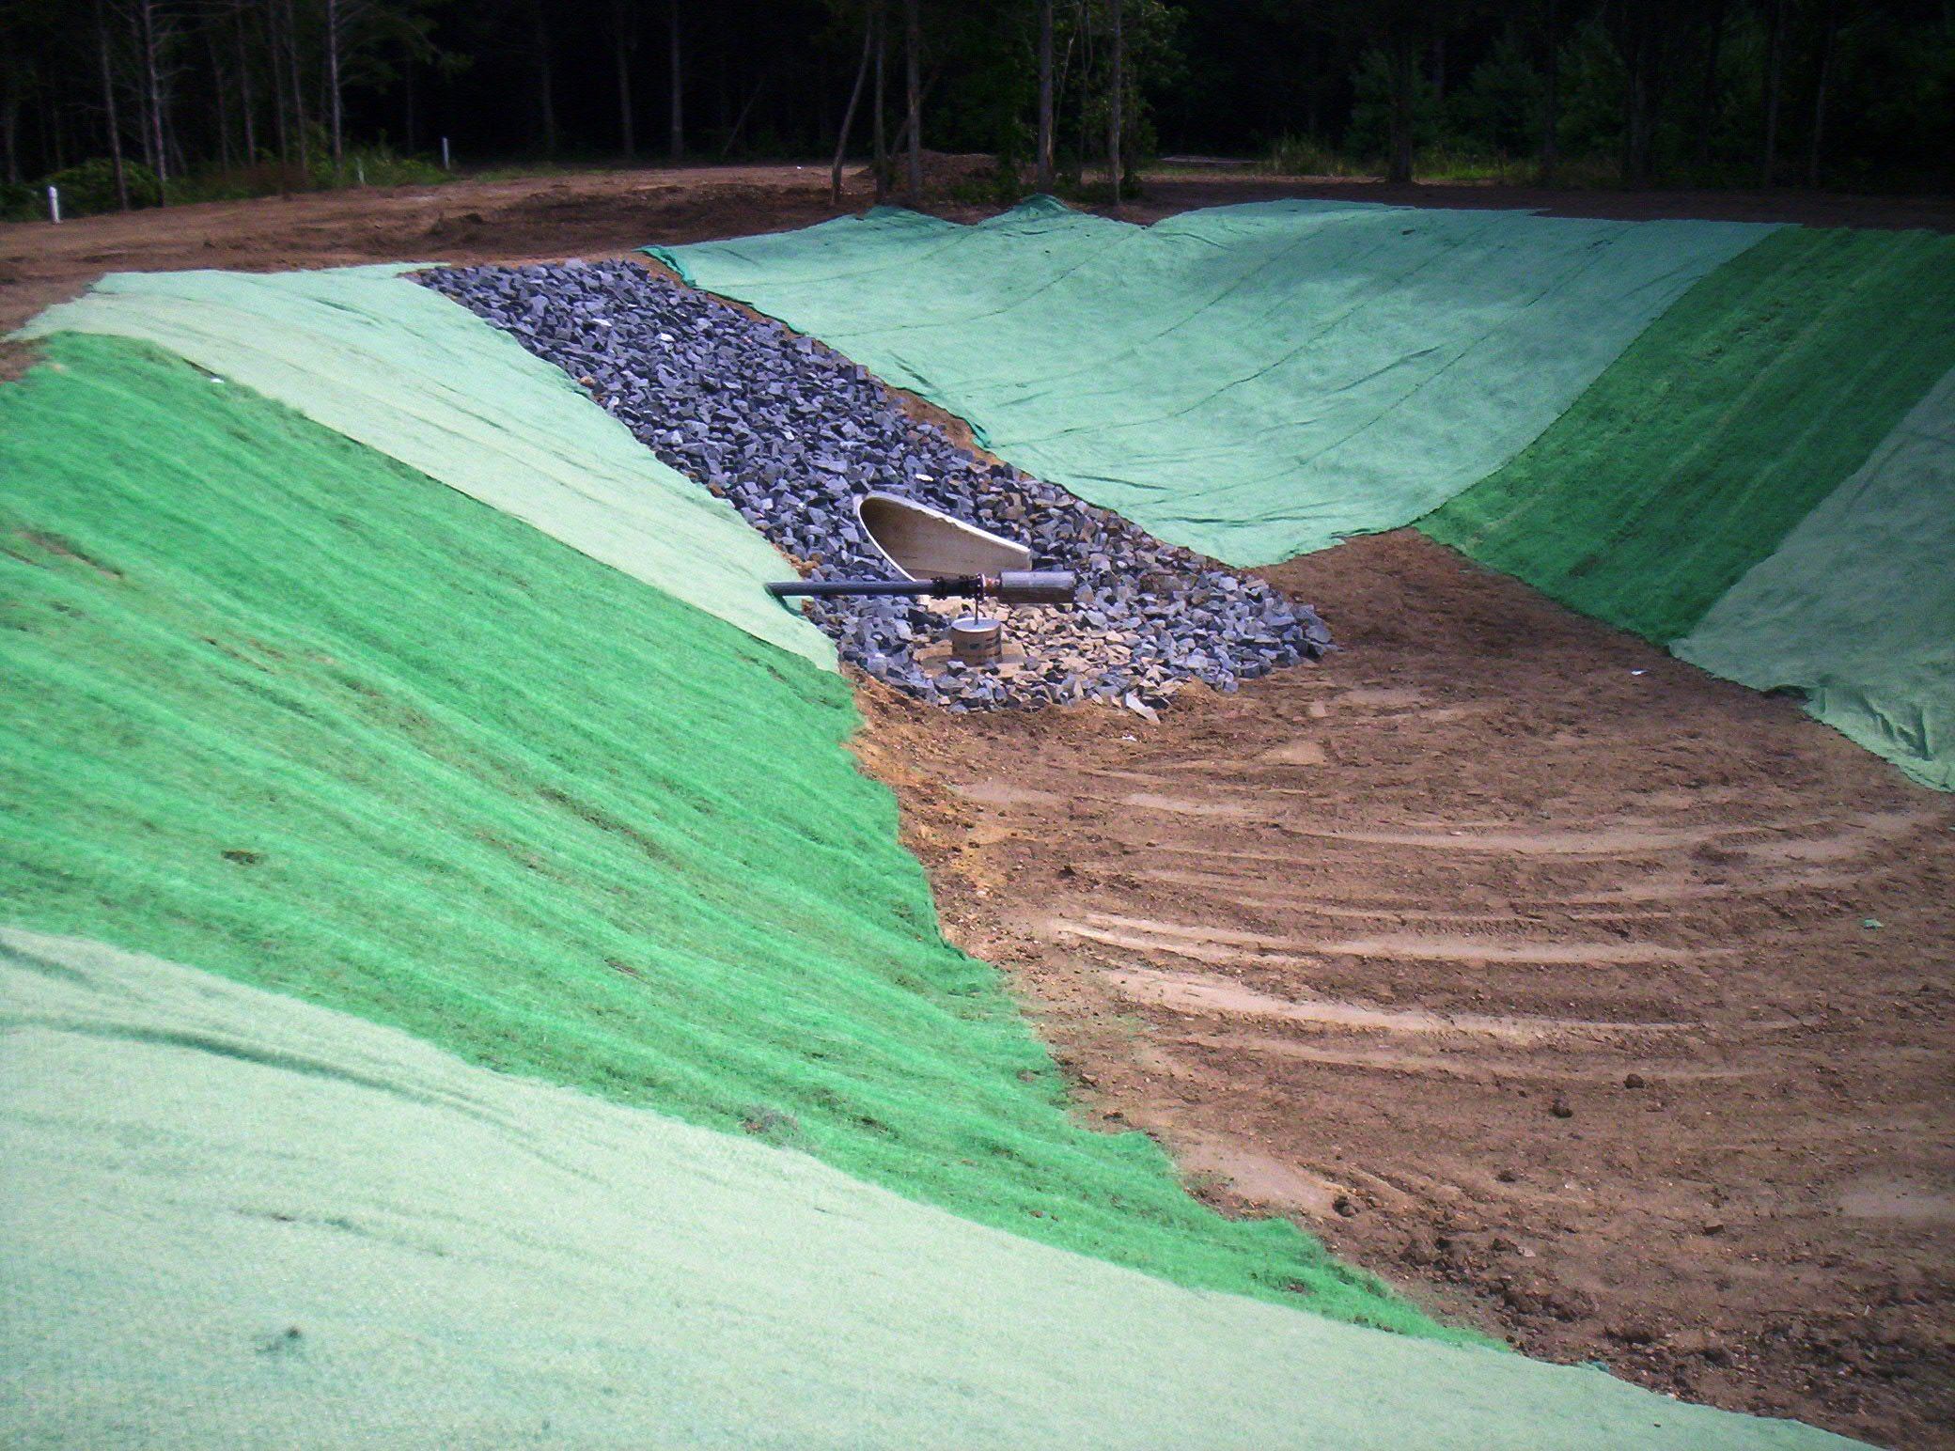
Areas of usage
Soil improvement
Erosion control

Slide 15
Bridge Properties

Slide 16
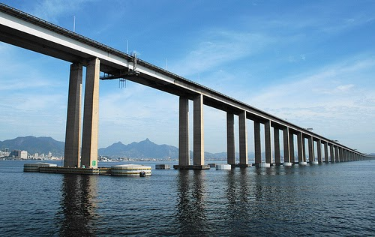
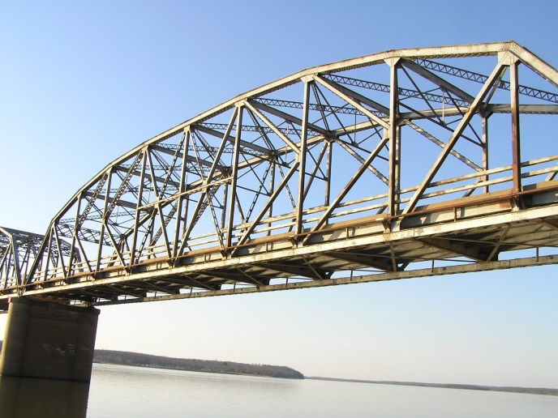
Types of Bridges
Beam Bridge
Truss Bridge

Slide 17
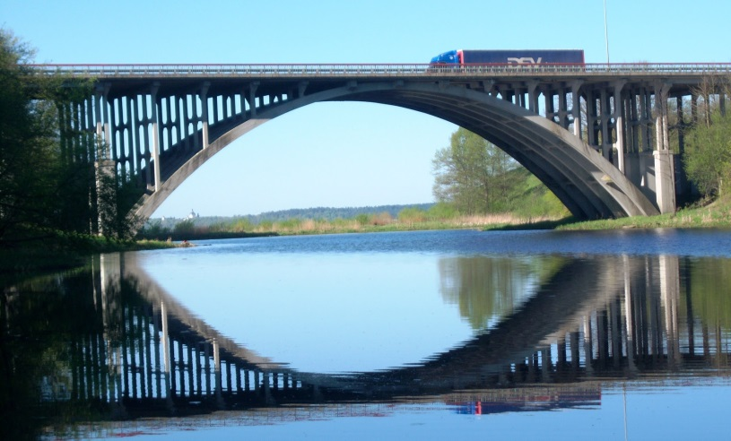
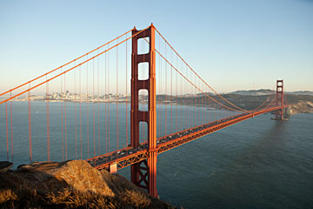
Types of Bridges
Arch Bridge
Suspension Bridge

Slide 18
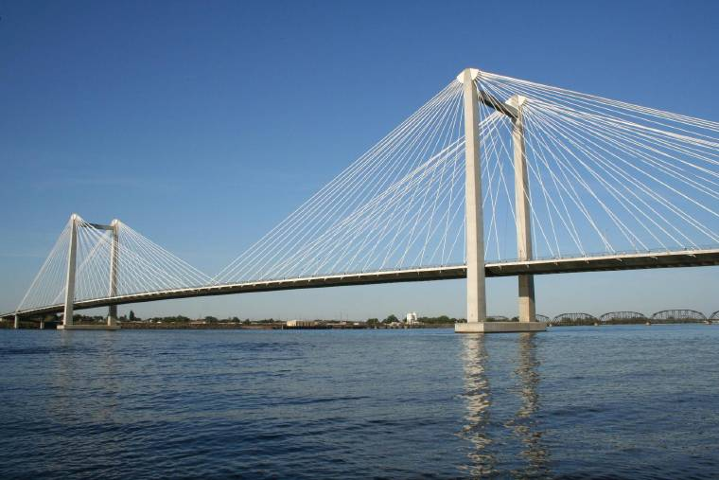
Types of Bridges
Cable – Stayed Bridge

Slide 19
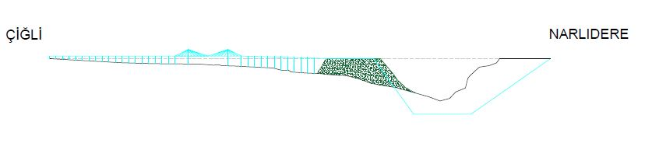
Section View

Slide 20
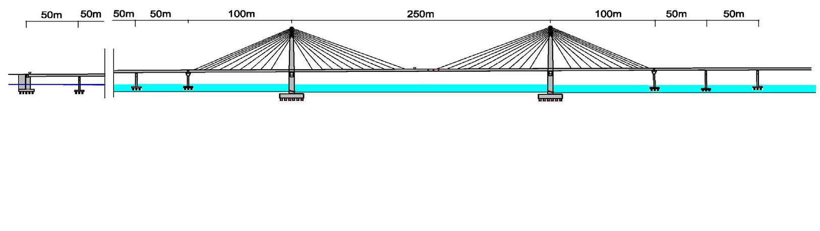
Properties of Highway

Slide 21
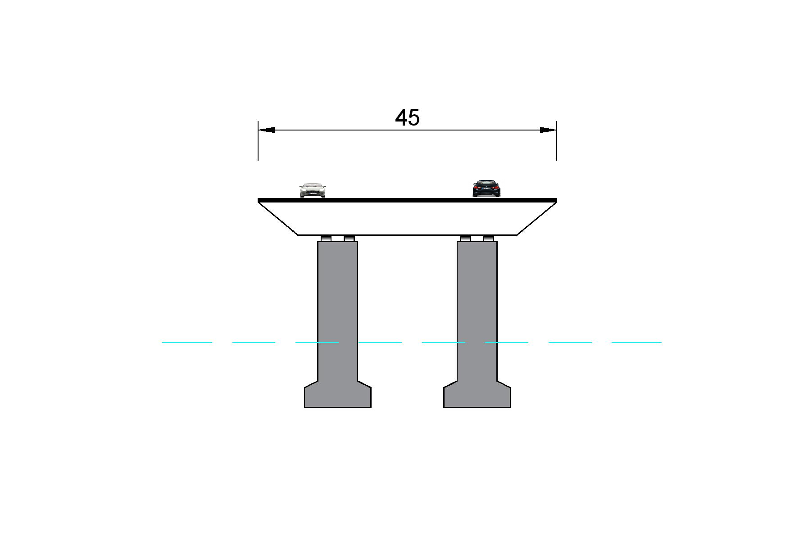
Properties of Highway

Slide 22
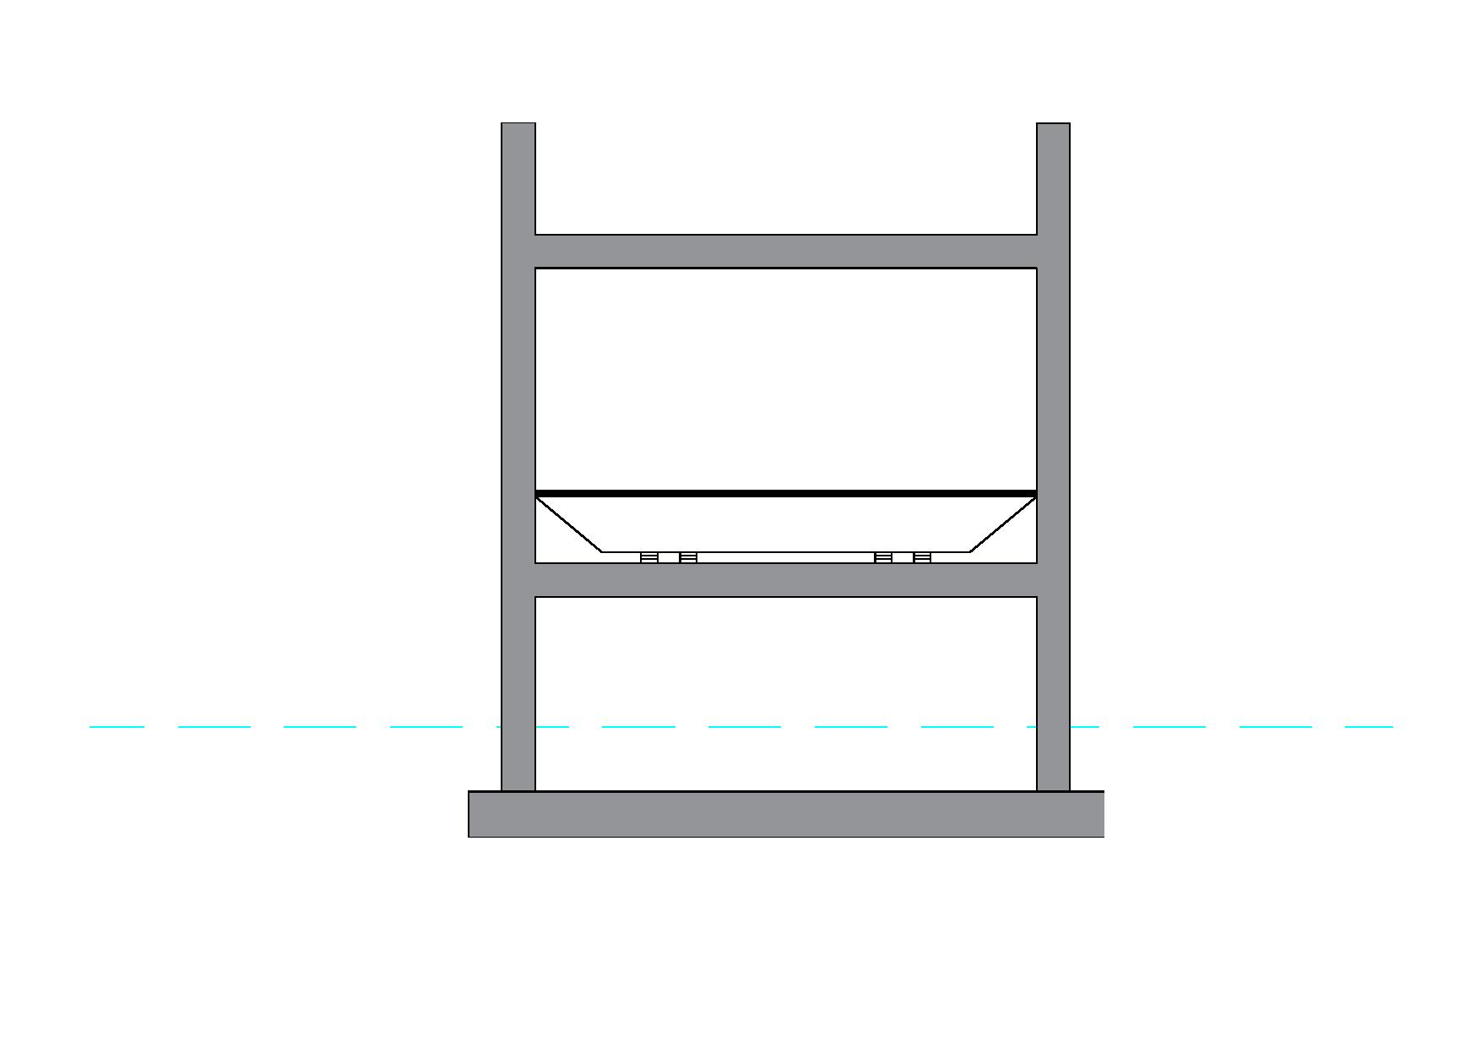
Properties of Highway

Slide 23
Artificial Island

Slide 24
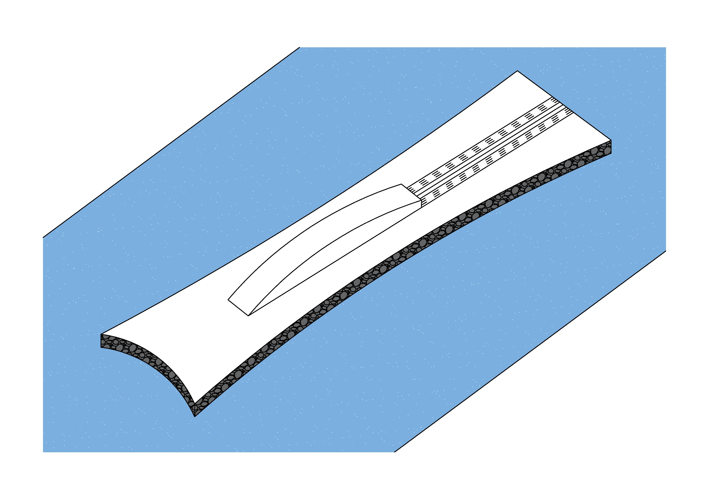
Design of Artificial Island

Slide 25
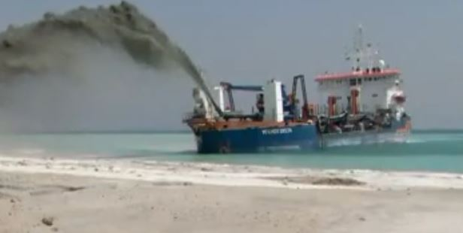
How Does Fill Artificial Island?

Slide 26
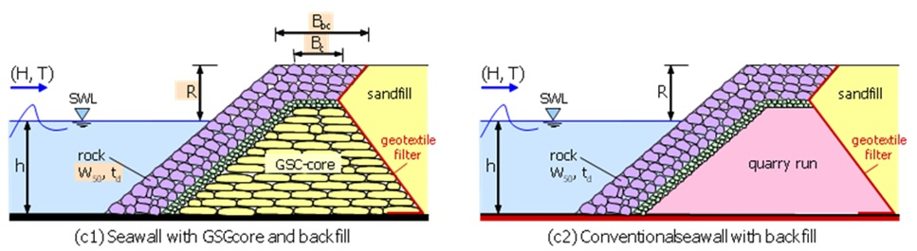
Layers of Artificial Island

Slide 27
Immersed Tube Tunnel

Slide 28
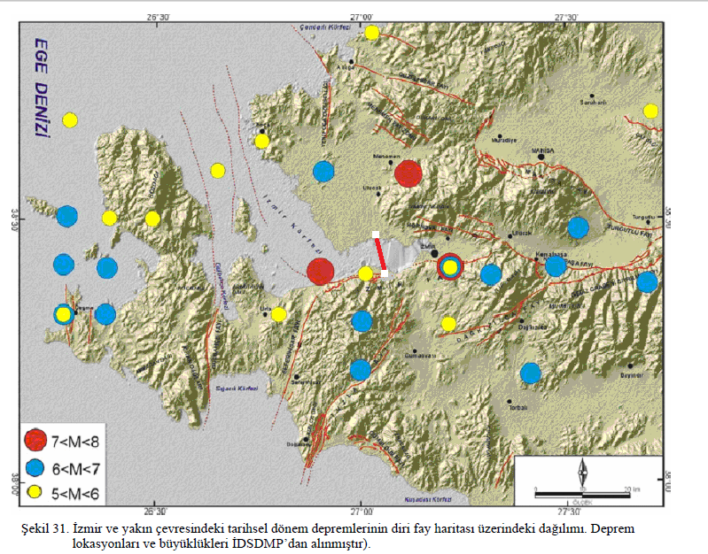
Location of Tunnel Relative to Fault Line

Slide 29
Design Loads of Tunnels
Dead Load (DL)
Live Load (LL)
Buoyancy (B)
Earthquake Force (EQ)

Slide 30
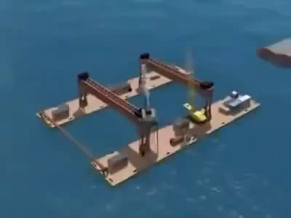
Placing of Tunnels

Slide 31
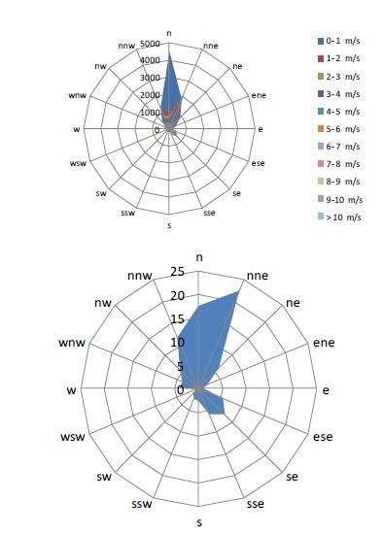
Wind in İzmir Bay

Slide 32
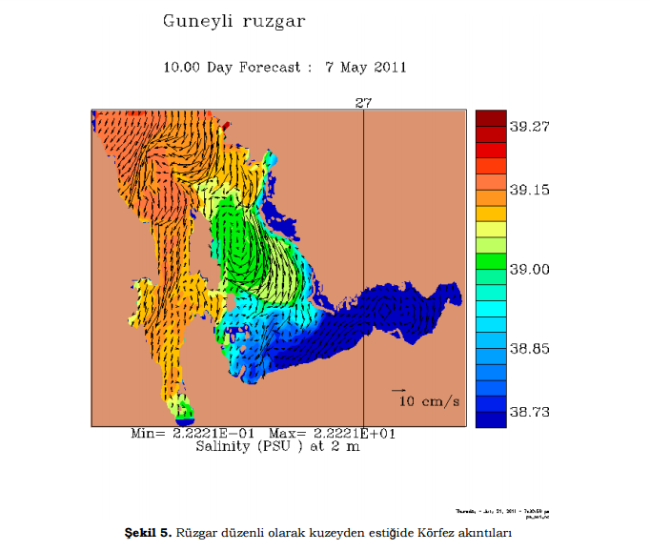
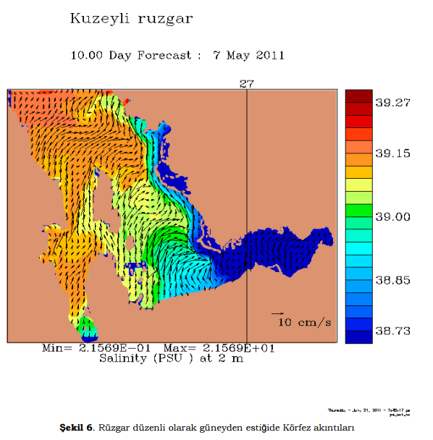
Wind Effects on Flow

Slide 33
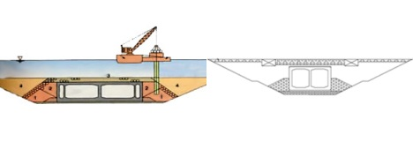
Underwater Concrete Pouring
Contractor

Slide 34
References
Körfez Yeniden Hayat Buluyor. (n.d.). Retrieved March 21, 2017, from http://www.izsu.gov.tr/Pages/standartPage.aspx?id=208
M.J. Tomlinson, Foundation Design and Construction, Pitman Books Ltd, London,1980,p.659 (Deniz Yapılarında Beton Üretim Teknikleri, Prof.Dr M.Süheyl AKMAN,, İTÜ İnş. Fak.)
N.KARTALTEPE (2008).PRELIMINARY DESIGN AND ANALYSIS FOR AN IMMERSED TUBE TUNNEL ACROSS THE İZMİR BAY. Retrieved from http://library.iyte.edu.tr/tezler/master/insaatmuh/T000768.pdf
Non-Conventional Rubble Mound Breakwater with Core made of Geotextile Sand Containers (Geocore Breakwater). (n.d.). Retrieved March 21, 2017, from https://www.tu- braunschweig.de/lwi/hyku/forschung/abgeschlosseneprojekte/ge ocore

Slide 35
References
Yılmaz, M. (2017, March 06). Bürokrasi, İzmir'e milyarları kaybettirdi | Mustafa Yılmaz. Retrieved March 21, 2017, from http://www.milliyet.com.tr/burokrasi-izmir-e-milyarlari-/mustafa- yilmaz/ege/yazardetay/06.03.2017/2408106/default.htm
http://www.kgm.gov.tr/
https://www.tmmob.org.tr/
KARTALTEPE, N. (2008). PRELIMINARY DESIGN AND ANALYSIS FOR AN IMMERSED TUBE TUNNEL ACROSS THE İZMİR BAY. Retrieved March 21, 2017.
İZMİR KÖRFEZİ VE LİMANI REHABİLİTASYON PROJESİ (İzmir İli, Konak İlçesi) ÇEVRESEL ETKİ DEĞERLENDİRMESİ RAPORU. (2016). Retrieved March 21, 2017
Erol, O., & Çekinmez, Z. (2014). “Geoteknik Mühendisliğinde Saha Deneyleri”. Retrieved March 20, 2017.
İzmir Körfezi ve Limanı Rehabilitasyon Projesi Liman Yaklaşım Kanalı, Manevra Dairesi, Liman Baseni,II. Kısım Konteynır Sahası ve Sirkülasyon Alanı Jeoteknik Raporu. (2013). 1-2. Retrieved March 20, 2017.

Slide 36
THANKS!
Any questions?

Slide 37
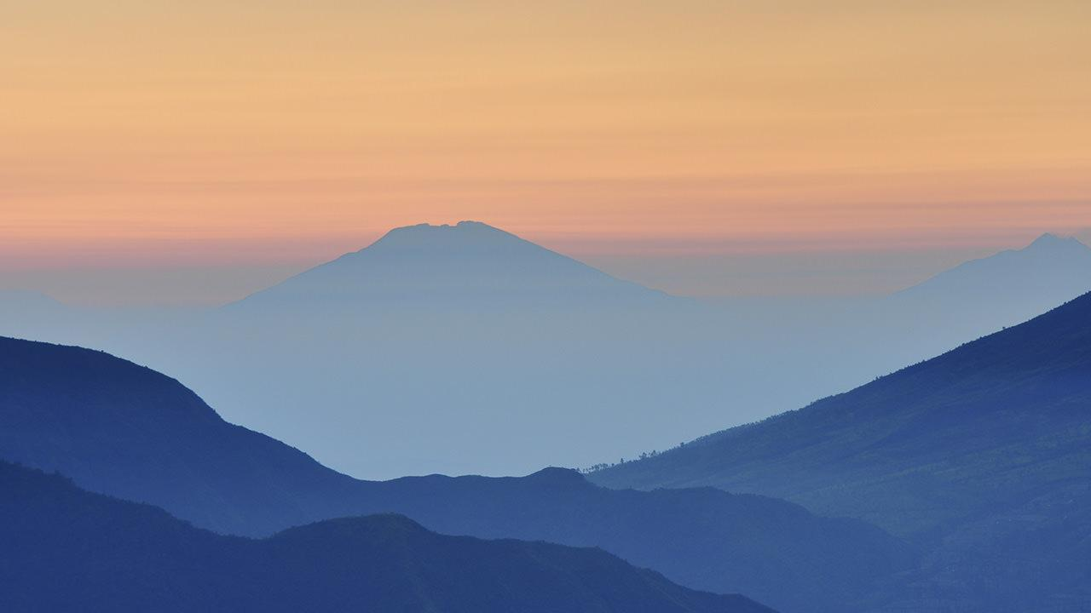
Want big impact?
USE BIG IMAGE.

Slide 38
AND TABLES TO COMPARE DATA
 | A | B | C
Yellow | 10 | 20 | 7
Blue | 30 | 15 | 10
Orange | 5 | 24 | 16

Slide 39
MAPS
Our Office

Slide 40
89,526,124
Whoa! That’s a big number, aren’t you proud?

Slide 41
89,526,124$
185,244 USERS
100%
That’s a lot of money
And a lot of users
Total success!

Slide 42
LET’S REVIEW SOME CONCEPTS
Yellow
Is the color of gold, butter and ripe lemons. In the spectrum of visible light, yellow is found between green and orange.
Blue
Is the colour of the clear sky and the deep sea. It is located between violet and green on the optical spectrum.
Red
Is the color of blood, and because of this it has historically been associated with sacrifice, danger and courage.
Yellow
Is the color of gold, butter and ripe lemons. In the spectrum of visible light, yellow is found between green and orange.
Blue
Is the colour of the clear sky and the deep sea. It is located between violet and green on the optical spectrum.
Red
Is the color of blood, and because of this it has historically been associated with sacrifice, danger and courage.

Slide 43
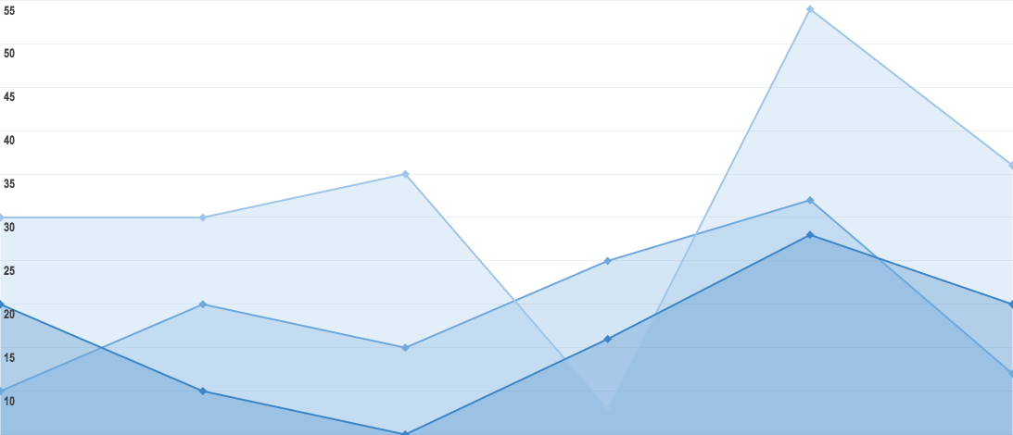
You can insert graphs from Google Sheets

Slide 44
ANDROID PROJECT
Show and explain your web, app or software projects using these gadget templates.
Place your screenshot here

Slide 45
iPHONE PROJECT
Show and explain your web, app or software projects using these gadget templates.
Place your screenshot here

Slide 46
TABLET PROJECT
Show and explain your web, app or software projects using these gadget templates.
Place your screenshot here

Slide 47
DESKTOP PROJECT
Show and explain your web, app or software projects using these gadget templates.
Place your screenshot here

Slide 48
CREDITS
Special thanks to all the people who made and released these awesome resources for free:
Presentation template by SlidesCarnival
Photographs by Unsplash

Slide 49
SlidesCarnival icons are editable shapes.
This means that you can:
Resize them without losing quality.
Change fill color and opacity.
Change line color, width and style.
Isn’t that nice? :)
Examples:

